Slide 1



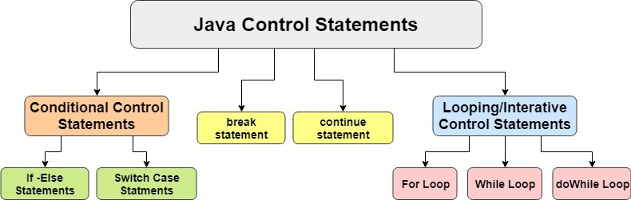
Control Statements in Java
V. Naga Bindu Sri

Slide 2
Contents
Introduction to Control Statements
Types of Control Statements
Conditional Statements
Looping Statements
Transfer Statements
Conclusion

Slide 3

Introduction to Control Statements
Control statements in Java are used for making decisions, repeating actions, and controlling program flow, providing the ability to create flexible and efficient applications.
Control statements are essential constructs in Java that allow you to manage the execution flow of your code by enabling conditional branching, looping, and transferring control within your programs.

Slide 4
Types of Control Statements
In Java, there are three main types of control statements:
Conditional Statements: Used for decision-making, including "if," "if-else," and "switch" statements.
Looping Statements: Used for repetition, including "for," "while," and "do-while" loops.
Transfer Statements: Used to control the flow of a program, including "break," "continue" statements.

Slide 5
Conditional Statements
Conditional statements in Java are used for decision-making in your code:
"if" Statement: Executes a block of code if a specified condition is true.
"if-else" Statement: Executes one block of code if a condition is true and another block if the condition is false.
"switch" Statement: Selects one of many code blocks to execute based on the value of an expression.

Slide 6
if-else Statement
Example
Here is an example of an if-else statement that checks if a number is even or odd:
int num = 5;
if (num % 2 == 0) { System.out.println(num + " is even");
}
else {
System.out.println(num + " is odd");
}
In this example, the if statement checks if the number is divisible by 2 (i.e. even). If it is, then the code within the if block is executed. If not, then the code within the else block is executed.
if-else statements in Java are used to make decisions based on certain conditions. The basic syntax of an if-else statement is as follows:
if (condition) { // code to be executed if condition is true}else { // code to be executed if condition is false}

Slide 7
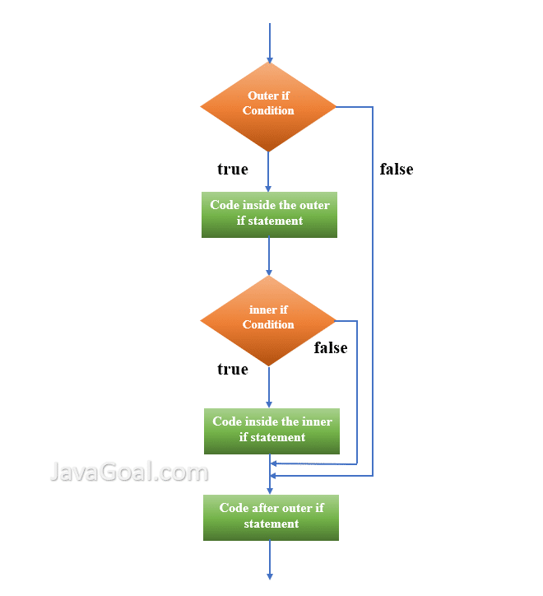
Nested if-else Statement
Nested if-else statements are used when we have to check multiple conditions. In nested if-else statements, an if statement is placed inside another if statement or an else statement.
The syntax for nested if-else statements is as follows:
if(condition1){ //code to be executed if condition1 is true
if(condition2){ //code to be executed if both condition1 and condition2 are true
} else{ //code to be executed if condition1 is true and condition2 is false
}
} else{ //code to be executed if condition1 is false }

Slide 8
Switch Statement
In Java, the switch statement is used to perform different actions based on different conditions. It is similar to if-else statements but is more concise and easier to read when there are multiple conditions.
Syntax
The syntax for a switch statement in Java is as follows:
switch(expression) {
case value1: // code to be executed if expression = value1;
break;
case value2: // code to be executed if expression = value2;
break;
... default: // code to be executed if expression is not equal to any of the values }

Slide 9
Switch Example
Example
Here is an example of a switch statement in Java:
int day = 4; switch (day) {
case 1: System.out.println("Monday");
break;
case 2: System.out.println("Tuesday");
break;
case 3: System.out.println("Wednesday");
break;
case 4: System.out.println("Thursday");
break;
case 5: System.out.println("Friday");
break;
case 6: System.out.println("Saturday");
break;
case 7: System.out.println("Sunday");
break;
}

Slide 10
Looping Statements
Looping statements in Java are used for repeating actions:
"while" Loop: Repeats a block of code as long as a specified condition is true.
"do-while" Loop: Similar to a "while" loop but guarantees at least one execution as the condition is checked after the code block.
for" Loop: Repeats a block of code a specific number of times based on initialization, condition, and increment/decrement.
"for-each" loop:used to iterate over elements in an array or a collection, simplifying the process of traversing each item without the need for explicit index tracking.

Slide 11
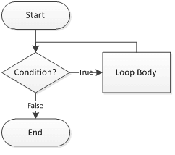
While Loop
A while loop is a control statement that repeatedly executes a block of code as long as the condition specified in the loop header evaluates to true. The loop continues to execute until the condition becomes false.
The syntax for a while loop is as follows:
while (condition) {
// code to be executed
}

Slide 12
Example of While Loop
int i = 1;
while (i <= 10) { System.out.println(i);
i++;
}
This program will print the numbers from 1 to 10 to the console.

Slide 13
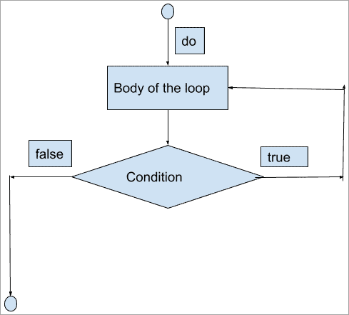
Do-While Loop
Do-while loops are similar to while loops, but with one key difference: the code inside the loop is always executed at least once, even if the condition is false. The syntax for a do-while loop is as follows:
do {// code to be executed} while (condition);

Slide 14
Example of Do-While
Here is an example of a do-while loop in Java:
int i = 0;
do {
System.out.println(i);
i++;
}
while (i < 5);
This code will print the numbers from 0 to 4, because even though the condition (i < 5) is false after the first iteration, the code inside the loop is still executed once.

Slide 15
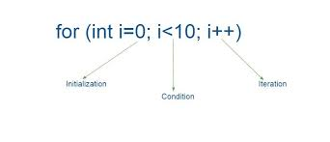
For Loop
For loops are used to iterate over a range of values or a collection of elements. They are often used when the number of iterations is known beforehand. The syntax for a for loop is as follows:
for (initialization; condition; update) { // code to be executed }
The initialization step is executed only once at the beginning of the loop. The condition is evaluated at the beginning of each iteration, and if it is true, the code inside the loop is executed. After each iteration, the update statement is executed before the condition is evaluated again.

Slide 16
Example Of For Loop
Here is an example of a for loop that prints the numbers from 1 to 5:
for (int i = 1; i <= 5; i++) {
System.out.println(i);
}
This will output:
1 2 3 4 5
In this example, the initialization step initializes the variable i to 1. The condition checks if i is less than or equal to 5. The code inside the loop prints the value of i, and the update statement increments i by 1 after each iteration.

Slide 17
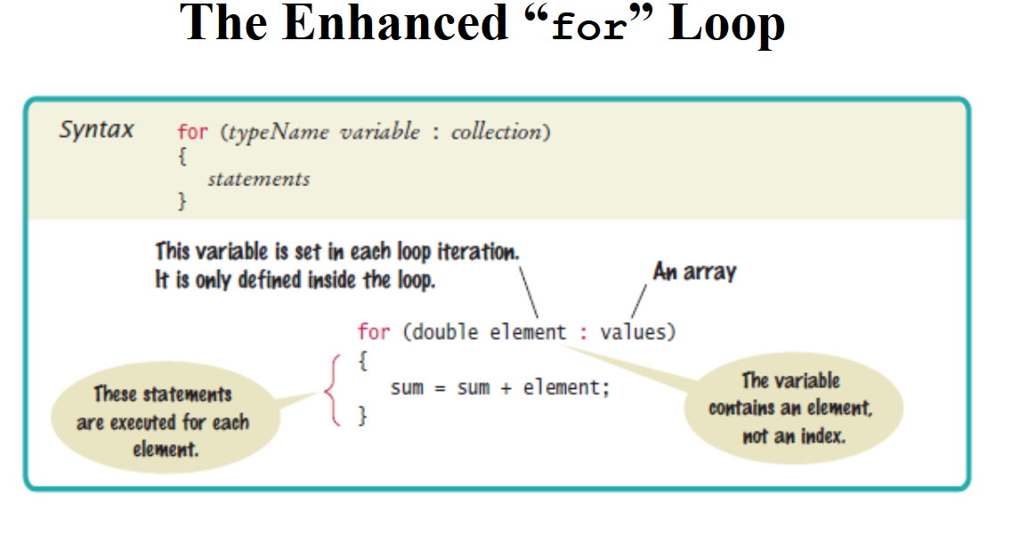
Enhanced For Loop
The enhanced for loop, also known as the for-each loop, is a simplified version of the traditional for loop used for iterating over arrays and collections in Java. It was introduced in Java 5 and has since become a popular choice for iterating over collections.

Slide 18
Examples
Here are some examples of using the enhanced for loop in Java:
Iterating over an Array
int[] numbers = {1, 2, 3, 4, 5};
for (int num : numbers) {
System.out.println(num);
}
Iterating over a Collection
List<String> names = new ArrayList<>();
names.add("John");
names.add("Mary");
names.add("Bob");
for (String name : names) {
System.out.println(name);
}

Slide 19
Transfer Statements
Transfer statements in Java are used to control the flow of a program:
"break" Statement: Exits a loop or switch statement prematurely.
"continue" Statement: Skips the current iteration of a loop and proceeds to the next iteration.

Slide 20
Break Statement
A break statement is used to terminate the execution of a loop or a switch statement. When a break statement is encountered inside a loop or a switch statement, the control is transferred outside the loop or switch statement.
Syntax
The syntax for using a break statement is as follows:
break;

Slide 21
Example​
The following example demonstrates the use of a break statement inside a for loop:​
for(int i=1; i<=10; i++){​
if(i==5){ ​
break; ​
} ​
System.out.println(i);​
}​
In this example, the for loop iterates from 1 to 10. When the value of i becomes 5, the break statement is executed and the control is transferred outside the loop. Therefore, the output of this program will be:​
1 2 3 4​

Slide 22
Continue Statement
The continue statement in Java is used within a loop to skip the current iteration and immediately proceed to the next iteration of the loop. It is often used to bypass a specific iteration when a certain condition is met.
Syntax:
Continue;

Slide 23
for (int i = 1; i <= 10; i++)
{
if (i % 2 != 0)
{
continue; // Skip this iteration if i is odd
}
System.out.println(i); // Print even numbers }

Slide 24
Conclusion
In conclusion, control statements are an essential part of programming in Java. They allow us to control the flow of our program and make decisions based on certain conditions or inputs. By using if-else statements, switch statements, and loops, we can create complex programs that can handle a variety of situations.
It's important to use control statements wisely and efficiently. Avoid common mistakes like infinite loops or using too many nested if-else statements. Follow best practices like using meaningful variable names and keeping your code clean and organized.

Slide 25





